Slide 1

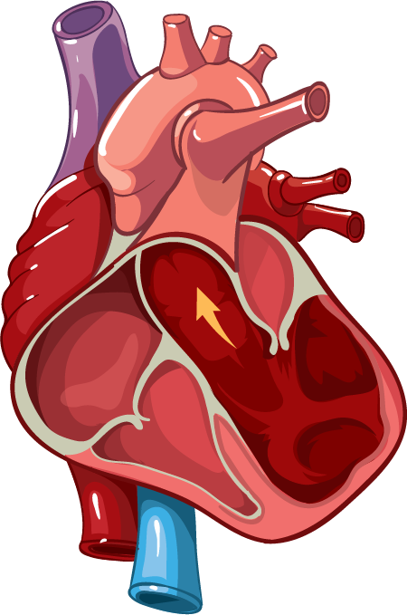
Predictive Modeling Using Framingham Data Will You Get Heart Disease in the Next 10 Years?
Presented by: Neha Sure

Slide 2
Table of contents
01
02
03
Introduction
Dataset & Features
Modeling Approach
04
05
06
Handling Imbalance
Model Evaluation
Conclusion & Future
Why heart disease prediction matters and what this study aims to do
Overview of Framingham dataset and selected health indicator
Algorithms explored and why SVM was chosen
Addressing class imbalance using class weights and SMOTE
Comparing naive SVM vs weighted vs SMOTE performance
Final findings, takeaways, and what's next

Slide 3
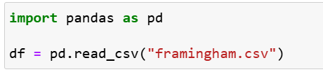

Introduction
Goal:
Predicting 10-year heart disease (CHD) risk using clinical and behavioral data.
Why does it matter?
Heart disease is the #1 global cause of death.
Early prediction enables timely intervention.
Supports doctors in risk screening and patient counseling.

Slide 4
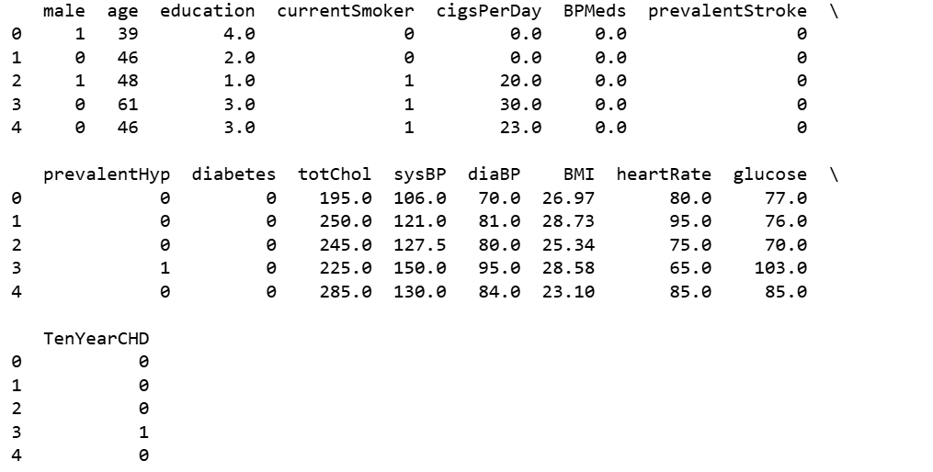
Data set
Kaggle: Framingham Heart Study
Total Records: 4,240 patient records
Target:
TenYearCHD 1=Yes 0=No

Slide 5
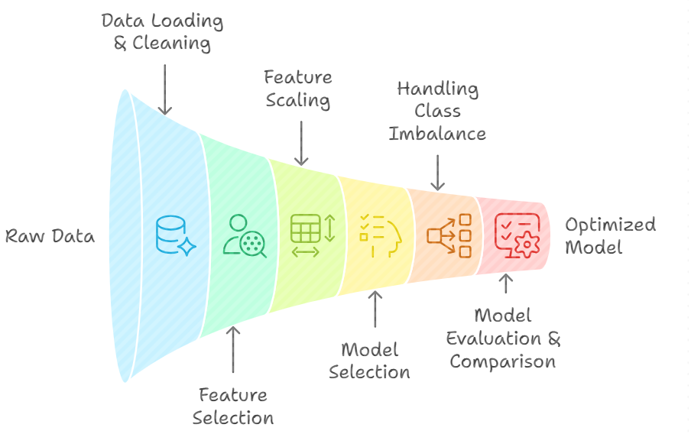
Project Workflow – Steps Followed
Data Loading & Cleaning
Feature Selection
Feature Scaling
Model Selection
Handling Class Imbalance
Model Evaluation & Comparison

Slide 6
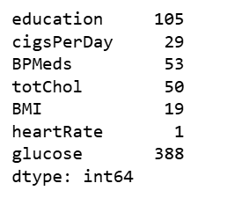

Data Loading & Cleaning
Loaded the dataset
Checked data types and missing values
Imputed missing values using mode (most frequent value)

Slide 7
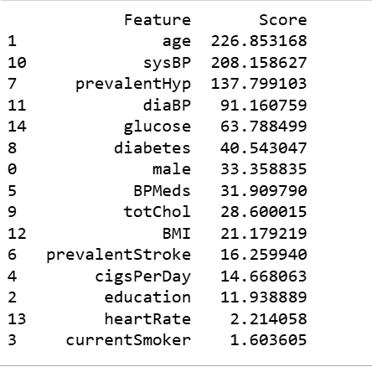
Feature Selection
Used SelectKBest with ANOVA F-test
Ranked features by their correlation with TenYearCHD
Selected top 8 features

Slide 8
Feature Scaling
Applied StandardScaler to normalize all selected features
Transformed data to have mean = 0 and standard deviation = 1
Essential for SVM, which uses distance-based calculations
Ensures fair comparison between variables with different units (e.g., glucose vs age)

Slide 9
Model Selection
Models: Logistic Regression, Decision Trees, Random Forest
Chose SVM (Support Vector Machine) due to:
Good performance with binary classification
Easy to interpret decision boundaries
Effective in high-dimensional spaces
Works well with small-to-medium datasets

Slide 10
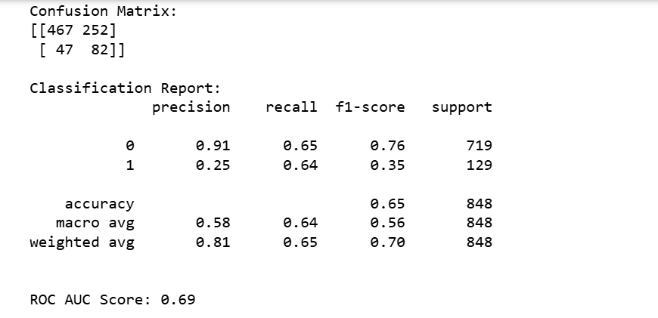
Model Evaluation
Trained SVM with class_weight=balanced to handle class imbalance

Slide 11
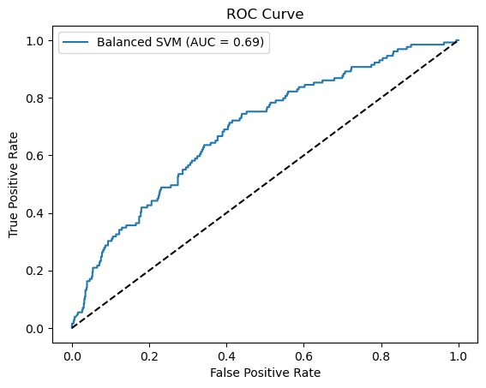

Slide 12
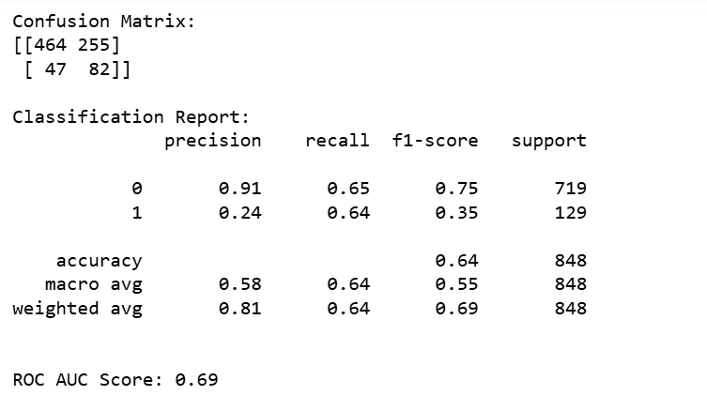
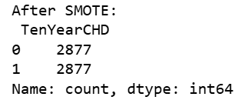
Further Improvement – SVM with SMOTE
Applied SMOTE to oversample minority class (CHD = 1) in training data.
SMOTE created synthetic data points to match class distribution.

Slide 13
Model Comparison
Model | Accuracy | CHD Recall (Class 1) | Precision (Class 1) | ROC AUC | Notes
SVM + Class Weights | 65% | 0.64 | 0.25 | 0.69 | Balanced performance with recall gain
SVM + SMOTE | 64% | 0.64 | 0.24 | 0.69 | Similar results, synthetic balancing

Slide 14
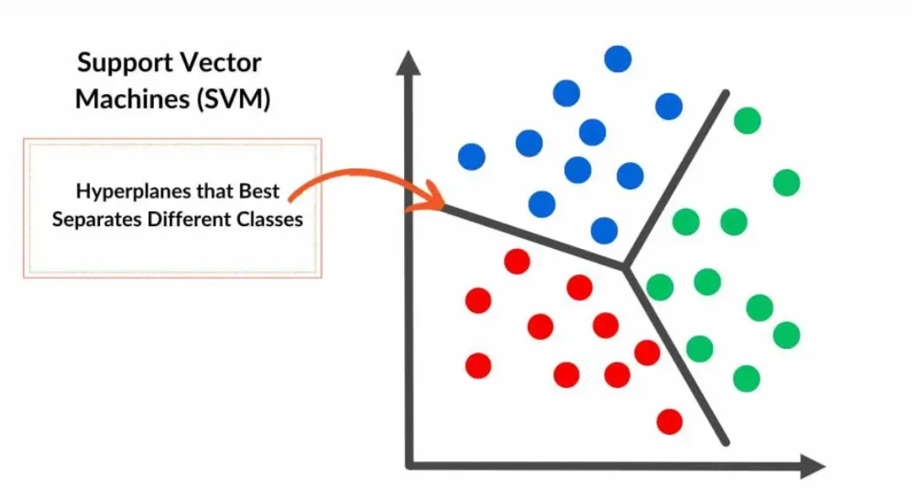
Conclusion
SVM effectively predicts 10-year heart disease risk.
Feature selection (ANOVA F-test) improved model focus.
Class imbalance was addressed using class weights and SMOTE.
Final models achieved 64% recall and 0.69 ROC AUC a meaningful improvement over the naive baseline.

Slide 15
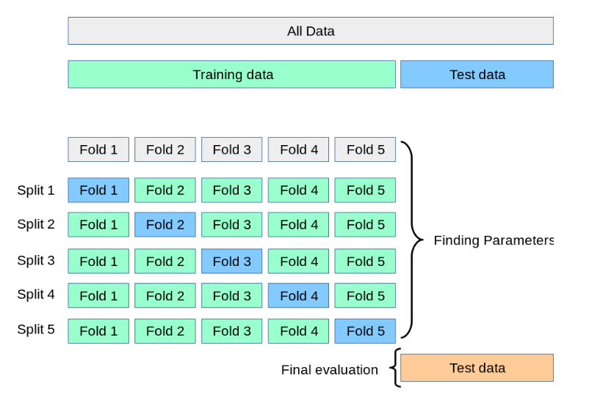
Future Work
Try ensemble models (Random Forest, XGBoost).
Apply cross-validation and hyperparameter tuning.
Build a simple app for clinical use

Slide 16

Do you have any questions?
Email: neha.sure@mnsu.edu
Linkedln: nehasure268

